Slide 1
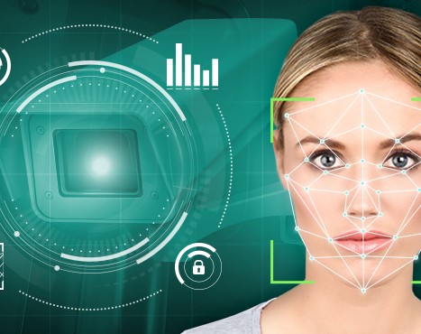
Image Recognition Web Application
CS7313 - Advanced Machine Learning and Pattern Recognition, Fall 2020
Sharmila Kanthaiya Srinivasan

Slide 2
Objective
Web application that can evaluate images and videos to perform image recognition.
The application is based on the data and machine learning model.
Given an image or video, the application would recognize the person's facial structure, gender.
The process involves various steps like grayscale conversion, face/object cropping, eigen image creation, training machine learning model, and prediction analysis

Slide 3


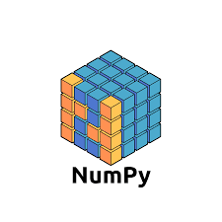

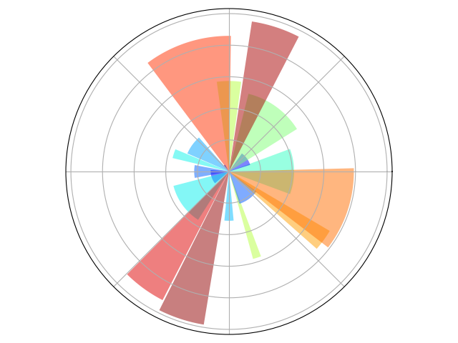




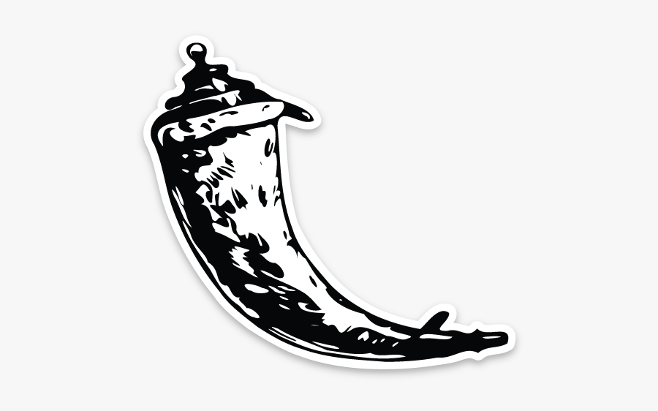
Project Components
HTML
CSS
Bootstrap
JS
OpenCV
NumPy​
Pandas
matplotlib
Scikit learn
P
Y
T
H
O
N
Image processing
Analysis
Preprocessing
MACHINE LEARNING
FLASK APP

Slide 4

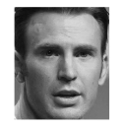
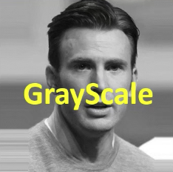

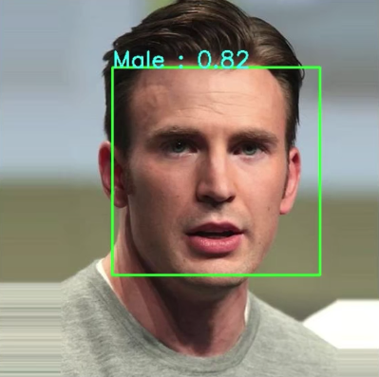
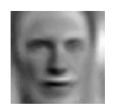
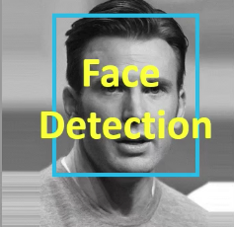
Gender recognition
O
P
E
N
C
V
N
U
M
P
Y
MALE – 0.82
FEMALE –0.18
Machine learning model
sklearn
Index, structure, normalize
S
K
L
E
A
R
N
Eigen image with PCA
Notes:
1. Goal is to get bounding box with gender and confidence score
2. In order to achieve it, I performed several sub modules like
Read image, grayscale conversion, face detection – using open cv library
Then to get confidence score and gender name, I need the machine learning model
So for that I cropped and structured the image then normalize image using numpy.
After that I computed eigen values using principle component analysis using sklearn
This resulted the model with gender and confidence score

Slide 5
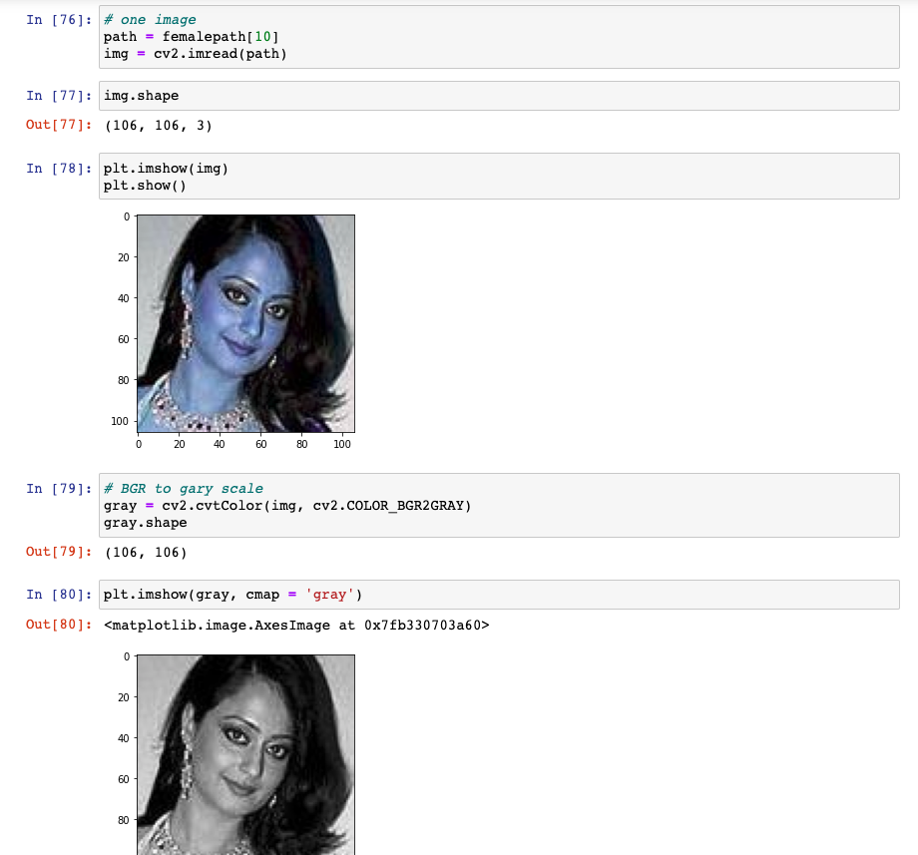
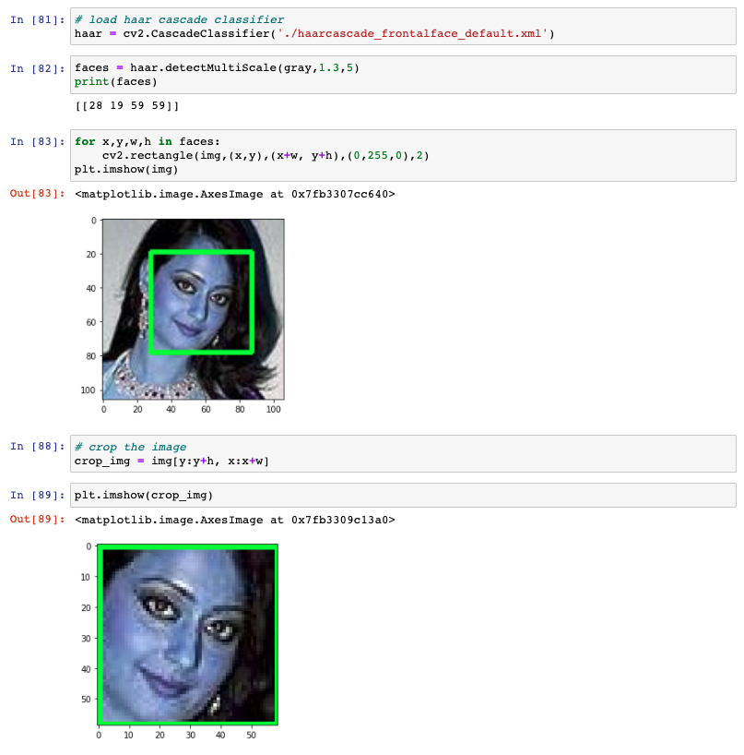
Data Cropping
Male folder
Read Image
Male crop folder
Crop Image
Female folder
Female crop folder
Notes:
I got the dataset from data vision website
The dataset containes images in 2 separate folder called male and female.
Total imgs are around 7000
So I just extracted the images and cropped it
Then moved it to new folders named male and female crop

Slide 6
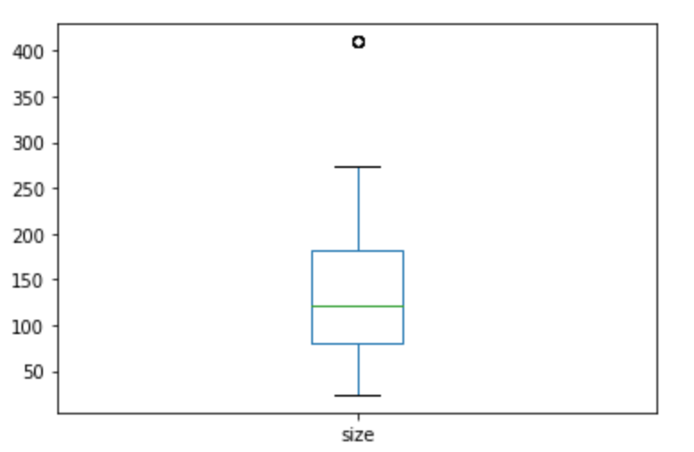
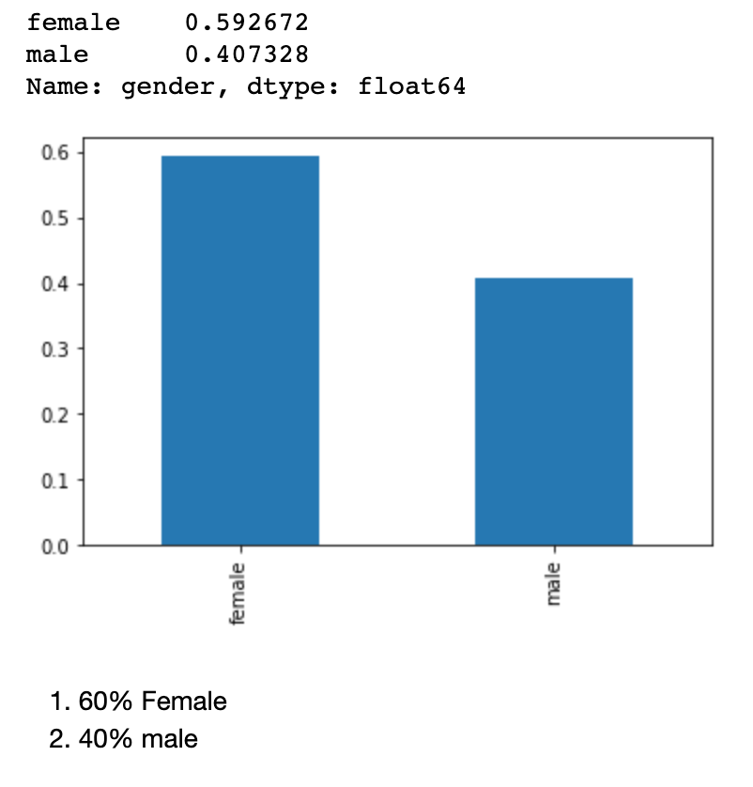
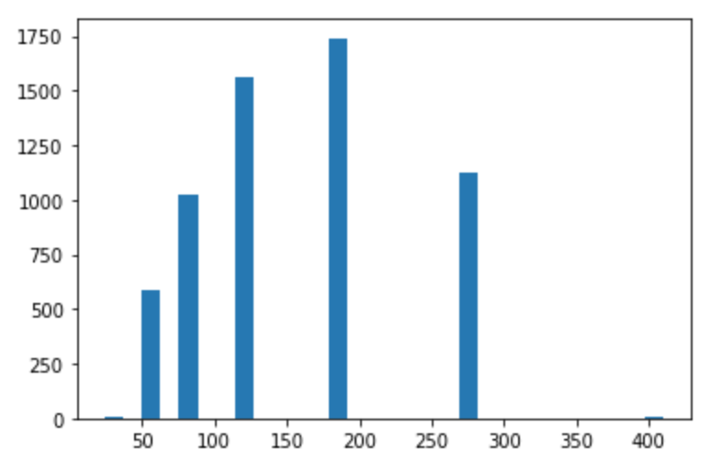
Data structuring - EDA
Box plot of data (male + female images)
Resized all the images to 100*100 array
Notes:
Open the folder and show all untructured images
They are in different width and height
If I train my model with the unstructured data, I will get proper result.
So I planned to structure the image by resizing it. So now question is, what is the ideal size, so did some data analysis. So for that I used pandas .
Then, this is box plot which I got for the total male and female image data.
Show the code and explain
So based on this box plot, I got to know that 75% of images size is > 81
Here is the histogram result,
So based on the histogram, images less than size 100 is around 1000
In that few iamges are less than 60. If you enlarge those you might lose the data.
Remaining are the major part. Since the remaining part is reasonably large, I worked on that
So, based on my analysis
1. I am planning to remove all the images with size less than 60.
2. Resize all remaining images to 100 x 100

Slide 7

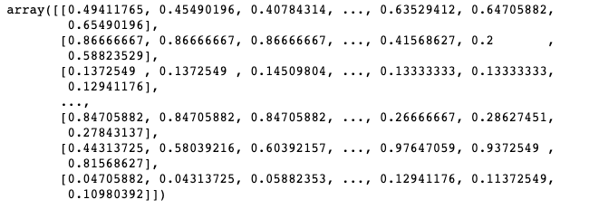
Data processing
After image resizing to 100 * 100
Flattened the image to one 1D array [10k]
Data normalization using min max scaling

Slide 8
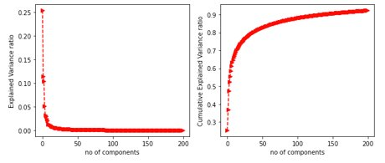
Principal Component Analysis
Elbow method for 200 components
Eigen images is technique of extracting features using Principal Component Analysis.
Principal Component Analysis (PCA) is an unsupervised, non-parametric statistical technique primarily used for dimensionality reduction in machine learning.
PCA can also be used to filter noisy datasets, such as image compression.
Eigen ratio
Eigen ratio cumulative
X axis – Number of components
Y axis – Explained variance ratio
X axis – Number of components
Y axis – Cumulative explained variance ratio
Notes:
High dimensionality means that the dataset has a large number of features.
The primary problem associated with high-dimensionality in the machine learning field is model overfitting, which reduces the ability to generalize beyond the examples in the training set.
The first principal component expresses the most amount of variance. Each additional component expresses less variance and more noise, so representing the data with a smaller subset of principal components preserves the signal and discards the noise.
PCA basically uses eigen values represent variance and eigen vectors represent direction. Basically , all the values are from the covariance matrix. So larger the variance means larger info is available in particular feature.
In order to do PCA, I need number of components. Initially, I just defined none. Then computed the number of components using elbow method.
So this pca.fit_transform will give you the covariance
Then using that, I computed eigenvalues and vector
Which eigen values are important – identified using elbow method
My shape size got reduced to row size because of auto svd_solver
Then eigen ratio nad eigrn ratio cumulative sum
Actually, there are 5461 components, to understand the chart clearly, I reduced it to 200
Graph 1 represents – individually explained variance of each and every component
Ex, the 1st component is 25% 2nd is 12%
Graph 2 for cumulative analysis. Ex, if you consider only one component, you will have 25%, 2 nearly 40% so on. If you check the 50 components you can get 80% of information. Theres is no need to look all the 10k componnets
In graph 1, you can see that optimal no. Of components settle down somewhere bet 25 to 30 and in graph 2 if we you consider 25 /30 no of components you will get 70% of variance. So I considere minimum of 80% of variance
In order to get good information, I selected 50 components
conclusion: using elbow method, consider number of components is between 25 - 30
since if I consider component between 25 to 30 the explained variance is around 75%. So, in order to get min 80% variance I am considering 50 components
This resulted in reduced dimension

Slide 9
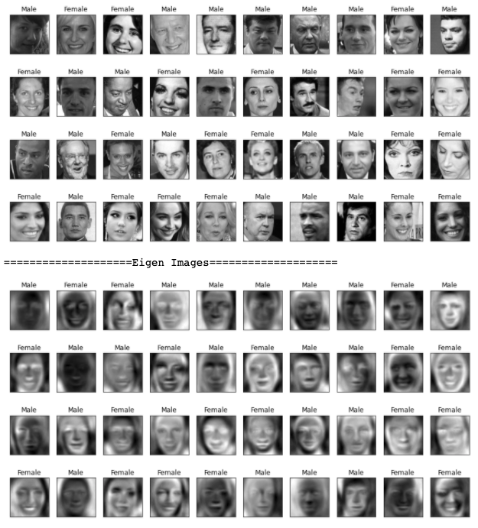
Eigen Images
I applied PCA to images and reduced the number of components.
Images with reduced components are called Eigen images.
Before PCA – 10k directions
After PCA – 50 directions
Inverse transform on 50 components
Notes:
So the images are converted into eigen imgaes
This is will help in indentifying the main facial features like eyebrow, nose and mouth position instead of calmness.
Based on those, gender can be classified

Slide 10
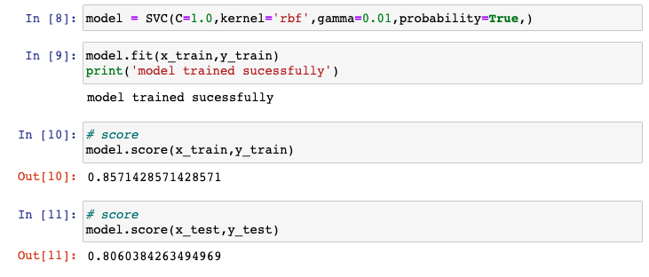
ML model training
Train and Test score
Trained the ML model using Support Vector Machine
Support vector machines (SVMs) are a set of supervised learning methods used for classification, regression and outliers detection.
The advantages of support vector machines are: Effective in high dimensional spaces. Still effective in cases where number of dimensions is greater than the number of samples.
Training samples – 4368 images
Testing samples –1093 ( 20 %)

Slide 11
ML model evaluation
Confusion matrix
Measure the performance of a classification problem
Classification report
This consist of recall, precision and accuracy.
Kappa score
Model selection is based on kappa score
AUC and ROC
Set probability to true while training the model with SVM
Notes:
AUC (Area Under The Curve) ROC (Receiver Operating Characteristics) curve. It is one of the most important evaluation metrics for checking any classification model’s performance.

Slide 12
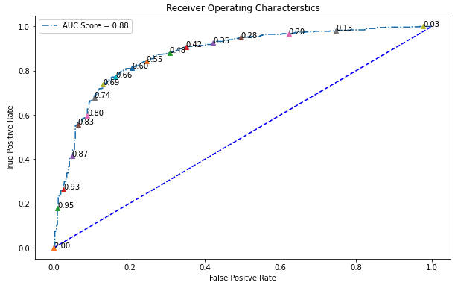
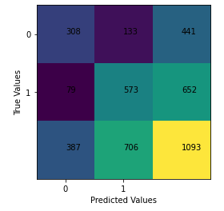
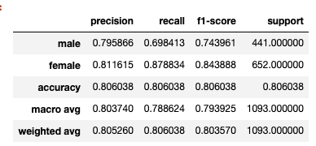
Model Evaluation
ROC and AUC (Probability)
Confusion Matrix
Kappa Score​
0.5889155002040201
Classification Report
Notes:
In confusion matrix, total test data is 1093
441 0 samples which are male samples. Out of 441, 317 are correctly classified and 124 are misclassifies
651 female samples, 557 correctly classified, 95 are misclassified
In clasiification report, male precision is 76% and female is 81%
Then I calculated the kappa score. This is will provide the random accuracy.
My kappa score is 57% - it is near good model range
In the ROC and AUC, the blue line is base line and the above is the arc
At default threshold point of 0.57, I got false positive rate is 20% and true positive is 80%
If you see the classififcation report, the recall of female is 85% for 50% default point
In my ROC, the 50% is near the 80%TPR, if I decrease it to 25%, then it is 95% TPR
Now My AUC is 85%, genearlly the AUC Is > then 80%, then it is good model
SO based on the analysis of kappa score and AUC the ML model is good to go

Slide 13
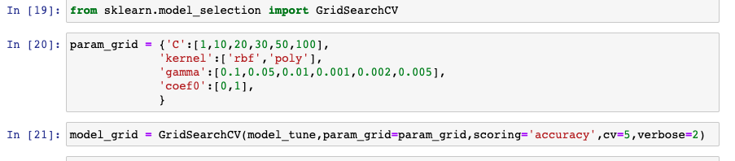
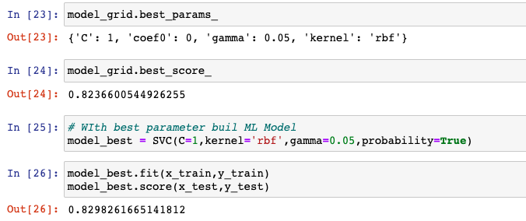
Hyper Parameter Tuning
Notes:
I tried to tune the model further by changing the SVC parameters like increasing the C (slcak variable), changing the gamma coefficient and I also tried to change the kernal functions.
This is almost same as my original model. SO my model score is same as previous.

Slide 14
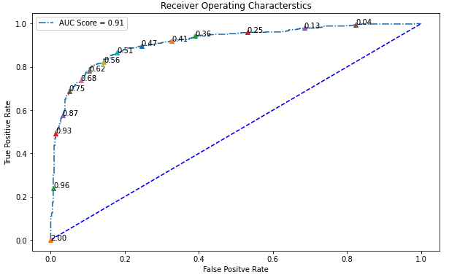
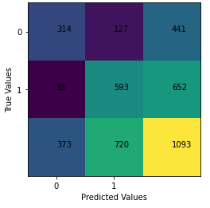
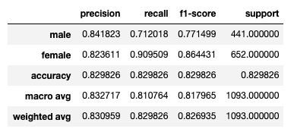
Hyper Parameter Tuning
ROC and AUC (Probability)
Kappa Score
0.6374314269612424
Confusion Matrix
Classification Report
Notes:
So this the output of the tuned model. There is no major change in the results

Slide 15
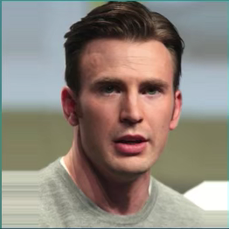
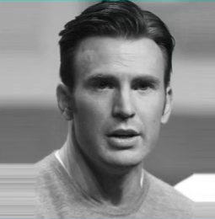
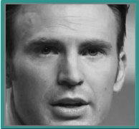

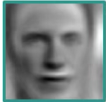
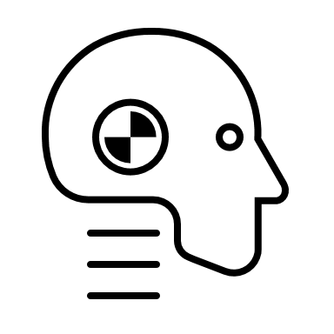
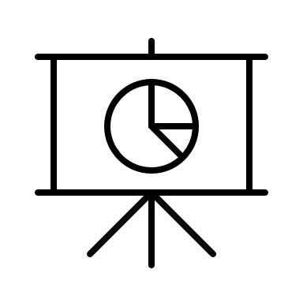
Pipeline
Read Image
Convert to Grayscale
Data Preprocessing
Resize image (100 *100)
SVM model
Crop Face
Normalize(0-1)
Output
Flatten image
Eigen Image

Slide 16
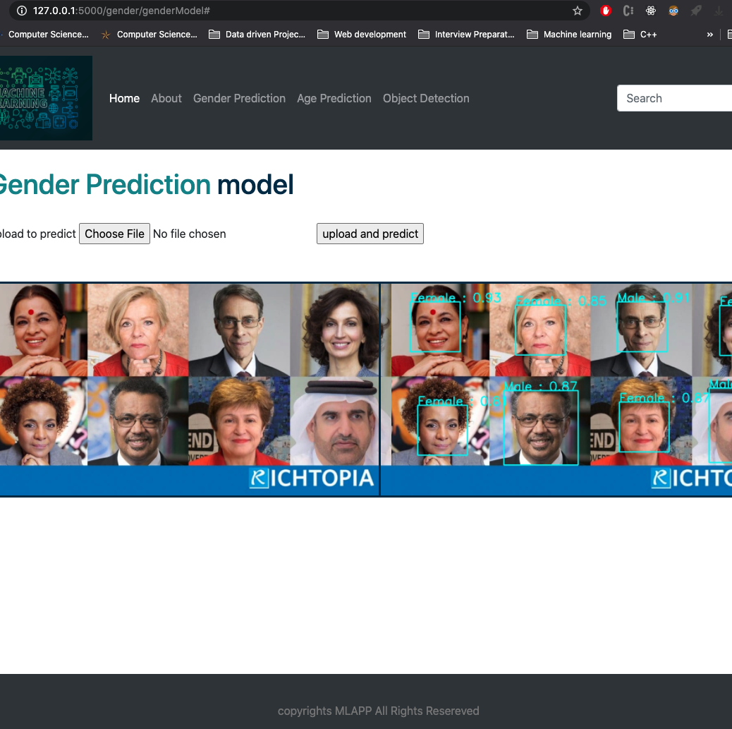
Website Demo
http://127.0.0.1:5000/
http://localhost:8888/tree/data

Slide 17
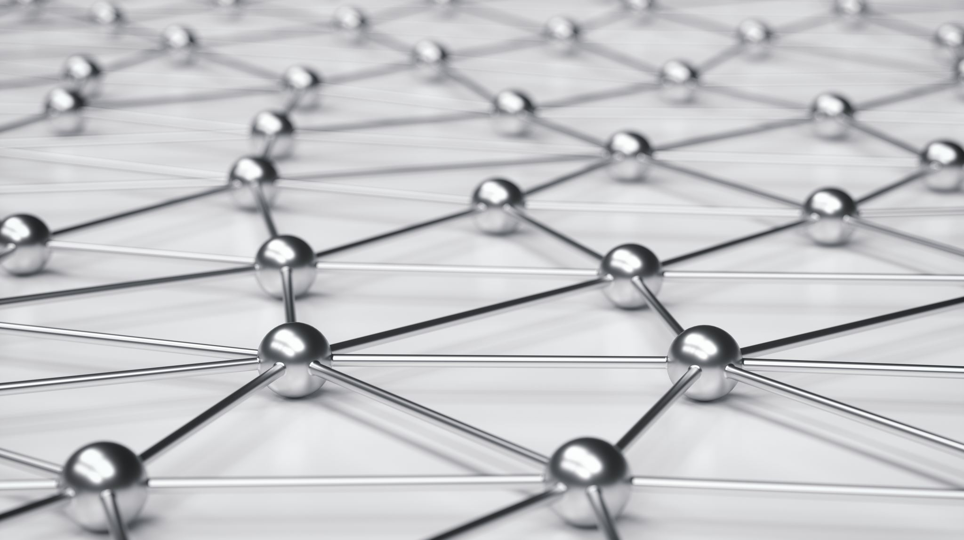
Future Work
Age Detection
Race Detection
Object Detection

Slide 18

Thank you

